Slide 1
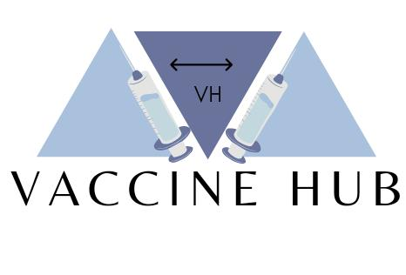
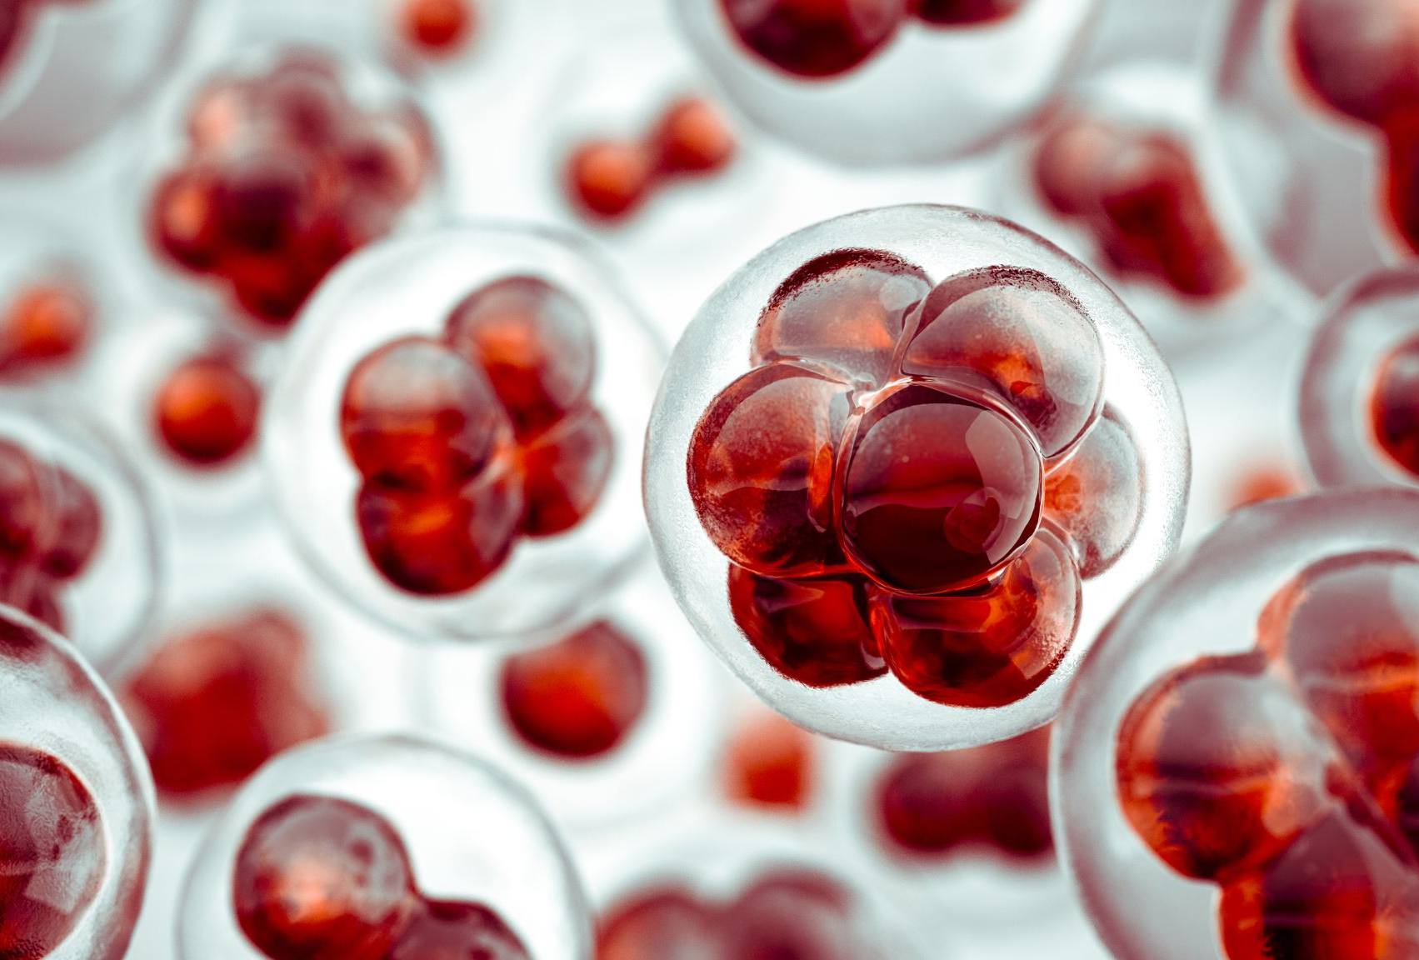
Vaccine hub
This is an initiative to develop a relation of transparency between public and vaccine distributors in this pandemic time.

Slide 2
Introduction
Vaccine Hub is an Indian hospital and manufacturer aggregator and vaccine delivery start-up founded by (our team name) on 19 December 2020. VaccineHub provides information of vaccine manufacturer as well as buyers from partner hospitals in all the cities across India. The service is available in country for 24hours a day always.

Slide 3
Benefits of our project
Quick access of vaccine to people
People can check the availability of vaccine at any time period
Corruption free source
Easy interaction between the manufacturer and buyer
Live Tracking of vaccine delivery
Query box
Vaccine requirements can be seen in numeric value as per demands
Safe, secure, open and transparent source

Slide 4
Key features of our website
1.1 from manufacturer to distributer vaccine hub helps to provide complete info and details regarding from, where, and how much vaccines is manufactured and distributes to vaccine centres it also further provides Information about ,editor and helps to keep track of the whole path. presiding and one -one to interactive between working body and user
1.2 filter and sort options are the sub element of search box as it will help users to narrow and organise their search results . it will help user to filter out states and cities on the basis of no. of corona virus patient present in that hospital.
1.3kinds of vaccines this features will provide user to access information regarding the kinds of vaccines that would be available in India and their efficacy rate and more information regarding it orders 1.5. this feature will enable medical department to issue the order of no vaccines by medical report of coronavirus patient.

Slide 5
Now let's see our heavy term "BLOCKCHAIN"
Blockchain is a shared, immutable ledger that facilitates the process recording transactions and tracking assets in a business network.
Virtually anything of value can be tracked and traded on a blockchain network, reducing risk and cutting costs for all involved.
Blockchain is ideal for delivering that information because it provides immediate, shared, and completely transparent information stored on an immutable ledger that can be accessed only by permissioned network members.
A blockchain network can track orders, payments, accounts, production, and much more. And because members share a single view of the truth, you can see all details of a transaction end-to-end,
giving you greater confidence, as well as new efficiencies and opportunities.
The way of storing data in it make it different from other ways of data storing.
Enormous amount of data and any type of data can be stored in block chain.
A fresh information is stored in block, when data is completely filled it get chained with other data which makes it most efficient and trustful source of data storing.

Slide 6
How "BLOCKCHAIN" is changing our lives today
block chains has many advantages and uses in daily life but one most common use is in transactions of bit coins.
its most important advantage is its transparency and it can't be hacked.
"BLOCKCHAIN" in our project
As pandemic hit the world, many issues are resolved with help technology and digitalization.
As our honorable prime minister said to make India as an independent and strong country, we could make this happen to use our technology for development of our country.
According to right to information, every citizen has right to know as well as access information and resources especially in this pandemic.
As vaccine is most important requirements of this time our people can use technology for transparency and accessibility to vaccine and how it's been used
Our project uses block chain to provide data of vaccine availability, delivery and storage in any area.
We could see that how many people are vaccinated and whom getting vaccinated.
by this we could also see live status of vaccine in nearby areas.

Slide 7
Contd....
Our project also shares vision of safe, secure and transparent network so everyone could
That’s we use Robustness, Cloud Computing and Kubernetes for decentralization and cost cutting of our project.
Robustness is the ability to satisfactorily manage exceptional situations.
It's all the more important in a decentralized autonomous network such as a blockchain where there are no intermediaries minding the store.
Blockchain-based cloud computing doesn't only decentralize data storage. More than ever, this technology is being used as part of data logistics platforms.
Many authorized users are allowed access to the data at once and can interact, interpret, and change it as they see fit.
Kubernetes is an open source project, you can use it to run your containerized applications anywhere without needing to change your operational tooling.
We can use Kubernetes for efficient architecture of our application.
By using technology we can make a transparent and inhackable network which makes a concord between government and public

Slide 8
Conclusion
Our project facilitates a great concord between vaccine distributors and public. Which is really important for establishing relation of trust and democracy.
About us
We are students of college CTAE Udaipur.

